Slide 1
Last Week
This Week
2D structure
Lumerical FDTD + Python
Lumerical FDTD + Python

Slide 2
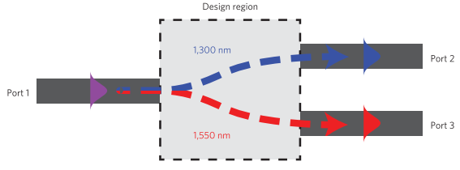
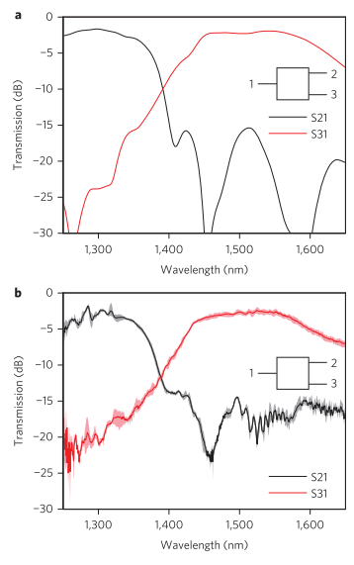
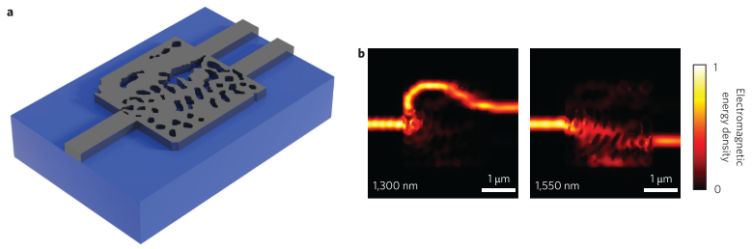
2015-nature photonics-vol 9-Inverse design and demonstration of a compact and broadband on-chip wavelength demultiplexer (Alexander Y. Piggott, Jesse Lu, Konstantinos G. Lagoudakis, Jan Petykiewicz, Thomas M. Babinec, Jelena Vuckovic)
220 nm Si layer on SiO2 substrate with air cladding ($n_{Si}=3.49, n_{SiO_{2}}=1.45, n_{air}=1$)
2.8 $μm$ x 2.8 $μm$ design region
FDTD simulation
Fundamental
TE mode
Fundamental
TE mode
Fundamental
TE mode
Measured

Slide 3
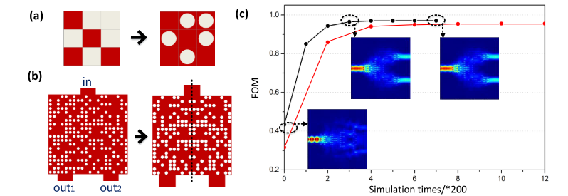
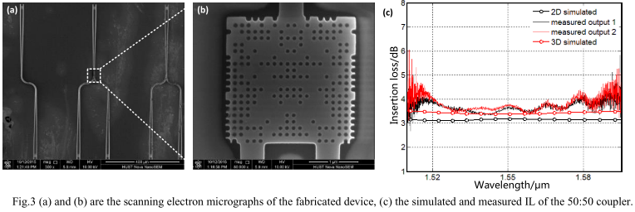
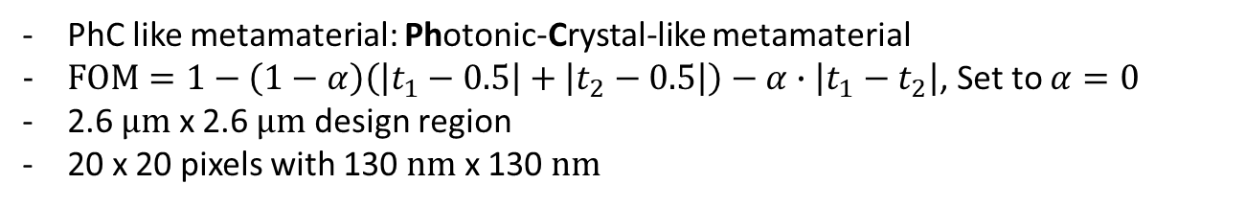

2016-Optical Fiber Communications Conference and Exhibition-An Ultra compact 50:50 Coupler Based on PhC like Metamaterial Structure (Luluzi Lu, Minming Zhang, Feiya Zhou, Deming Liu)
PhC like metamaterial: Photonic-Crystal-like metamaterial
$FOM=1−\left(1−α\right)\left(\left|t_{1}−0.5\right|+\left|t_{2}−0.5\right|\right)−α∙\left|t_{1}−t_{2}\right|$, Set to $α=0$
2.6 $μm$ x 2.6 $μm$ design region
20 x 20 pixels with 130 $nm$ x 130 $nm$
symmetric
random
random
symmetric
$$Insertion Loss=−10\log\left(t/T\right)$$

Slide 4
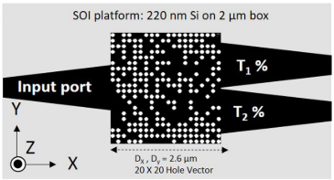
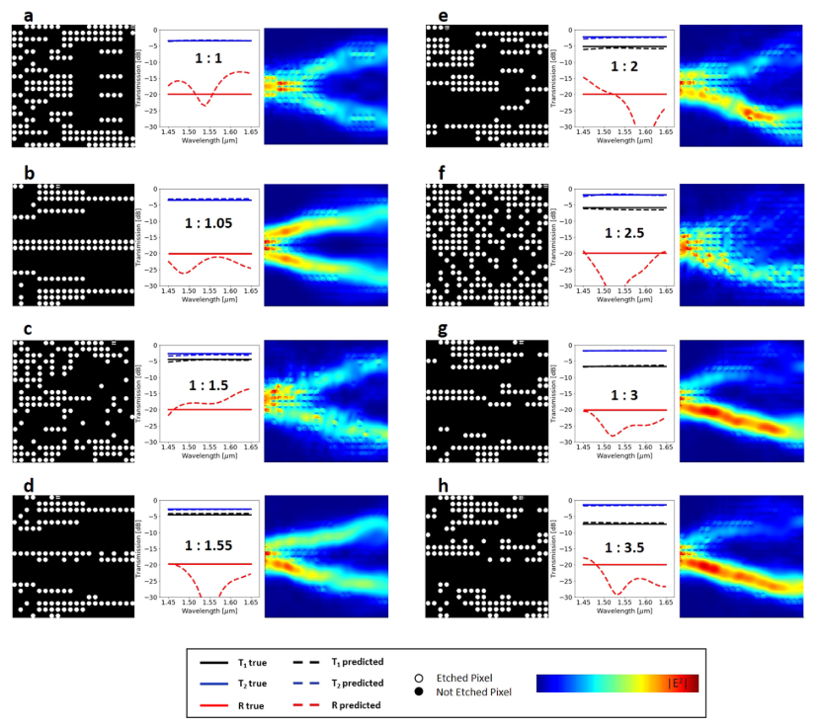
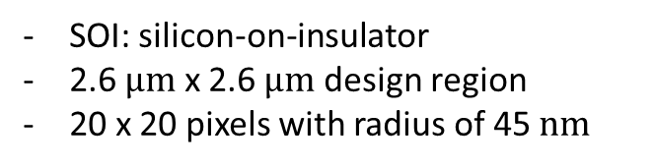
2019-Scientific Reports-9, 1368-Deep Neural Network Inverse Design of Integrated Photonic Power Splitters (Mohammad H. Tahersima, Keisuke Kojima, Toshiaki Koike-Akino, Devesh Jha, Bingnan Wang, Chungwei Lin, Kieran Parsons)
SOI: silicon-on-insulator
2.6 $μm$ x 2.6 $μm$ design region
20 x 20 pixels with radius of 45 $nm$

Slide 5
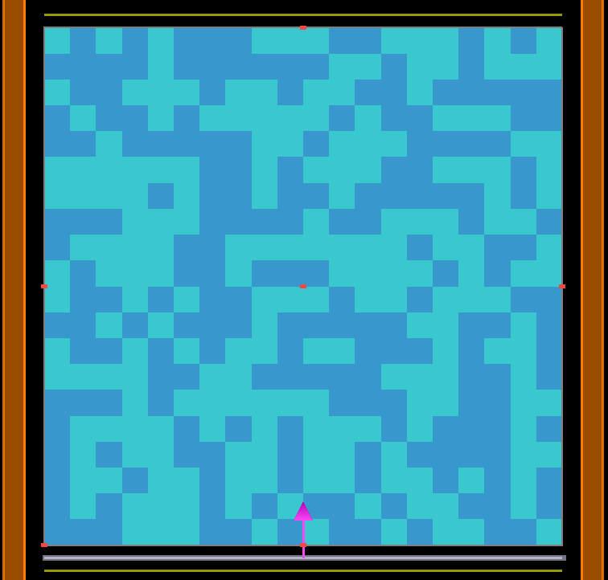
2D DBR
Transmittance
monitor
20 x 20
Source
Reflectance
monitor

